Slide 1

Bank marketing
Norah sulaiman Alogla

Slide 2
Bank marketing analysis using machine learning
In this project I will try to perform exploratory data analysis and build a machine learning model to Predict if a client will subscribe (yes/no) to a term deposit in the bank.
Understanding the problem
Increasing the number of client who deposit their money in the bank by analyzing their past marketing campaign data and recommending which customer to target. And this is defined as a classification problem.

Slide 3
Data Exploration
Dataset contained 17 different features and 11162 clients. Features were both categorical and numerical. Target variable was binary (“yes” or “no”).
The dataset gives us information about a marketing campaign of a financial institution in which you will have to analyze in order to find ways to look for future strategies in order to improve future marketing campaigns for the bank. So here we will import the dataset that describe.

Slide 4
Features are

Slide 5
deposit | object | has the client subscribed a term deposit? (binary: 'yes’, ‘no’).
My Target or Label:

Slide 6
Clean the data
Data preparation
I will perfume these step to make sure everything is ready on my data analysis:
Feature Engineering
Drop unwanted Features
Handle Missing Values
Handle Categorical Features
Handle Feature Scaling
Remove Outliers

Slide 7
Categorical features
Numerical features = 7
Categorical features = 10

Slide 8
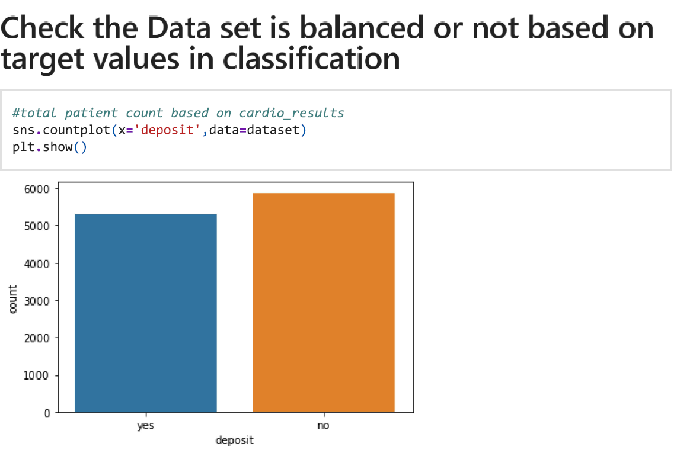
As data analysis I need to follow the step to prepare the data for machine learning to build a model that predict if the client will deposit in the bank or not.
Check the dataset

Slide 9
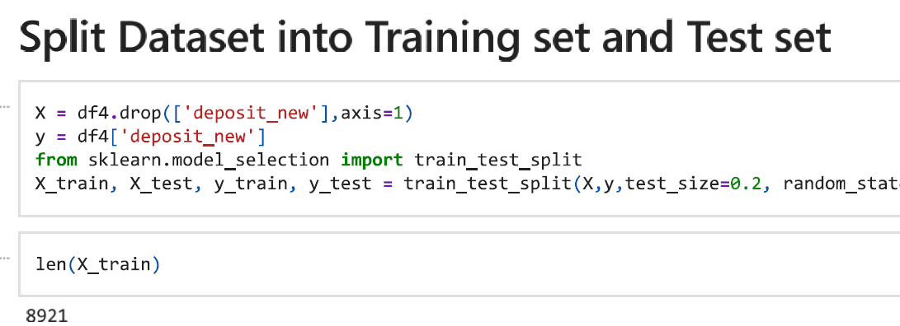
I need to split the data in order to test and train the model

Slide 10
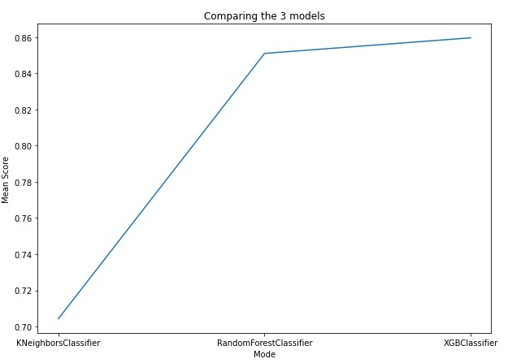
model selection
For this classification project, We have many different models like a Logistic Regression, Decision Tree, Random Forest classifier, XGBclassifier and many other models.
I used 3 models which are KNN, Random Forest classifier, and XGB Classifier.
From the results I found that: XGB Classifier has the best performance on the data and achieve the best accuracy.

Slide 11

model building
For the Evaluation:
I used many different methods to be sure that our model performs well on the data.
I used the Accuracy matrix, Confusion Matrix, and the ROC Curve.
The model achieved 0.858 accuracy which is acceptable.

Slide 12
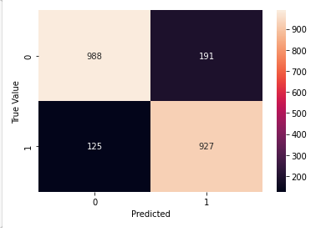
For the Confusion Matrix
It describes the number of True Positives and True Negatives comparing to the number of False Positives and False Negatives.
Our goal is to maximize the number of trues and minimize the number of false.
0 means no deposit and
1 means deposit

Slide 13
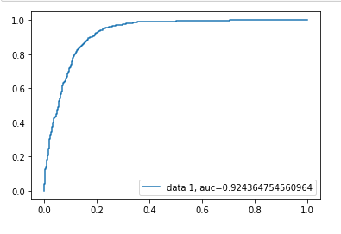
For the ROC Curve:
People usually called it as the Area Under Curve(AUC).
It describes the relation between the number of true positives on the y axis and the number of false positive on the x axis.
Our goal is to maximize the number of true positive and minimize the number of false positives.
Or we can say we want to maximize the area under the curve.
The max value for the (AUC) equals 1.
Our model has successfully achieved AUC equals 0.92.

Slide 14
CONCLUSION
For Exploring the dataset: I found that our dataset is clean and doesn’t contain any missing values.
For data preprocessing we apply many changes to the data to make it ready and pass it to the model ex: drop the past days that have negative values.
The third step was splitting the data into training and testing data.
The final step was building the model I tried many models and I choose the XGB classifier as our final model.
From the results we found the number of the clients who not deposit is more than the clients who made deposits.
I suggest to make more campaigns to encourage clients to make more deposits in our bank to increase the income.

Slide 15
Thank you for listening

